Slide 1

Stock Market Analysis & Predictive Modeling
IA605 Capstone Project
Shylendra Sai Bangaru
Hemamalini

Slide 2

Introduction
Financial markets today are fast-moving, unpredictable, and fueled by massive streams of data.
Traditional investing methods are slow, manual, and can’t keep up with the pace.
Investors now need smart, scalable, and automated strategies.
This is where AI-powered decision making comes in.
AI can spot hidden patterns, adapt quickly, and learn from data to make better investment decisions.

Slide 3
Project Goals
Predict tomorrow’s stock prices using deep learning to stay ahead of market moves
Build smarter portfolios using Modern Portfolio Theory (MPT) to balance risk and reward
Make AI-driven Buy/Sell/Hold decisions — removing bias and emotion
Spot unusual trading patterns to detect possible manipulation or insider trading
Backtest our strategy on real market data to prove its effectiveness in real-world scenarios

Slide 4
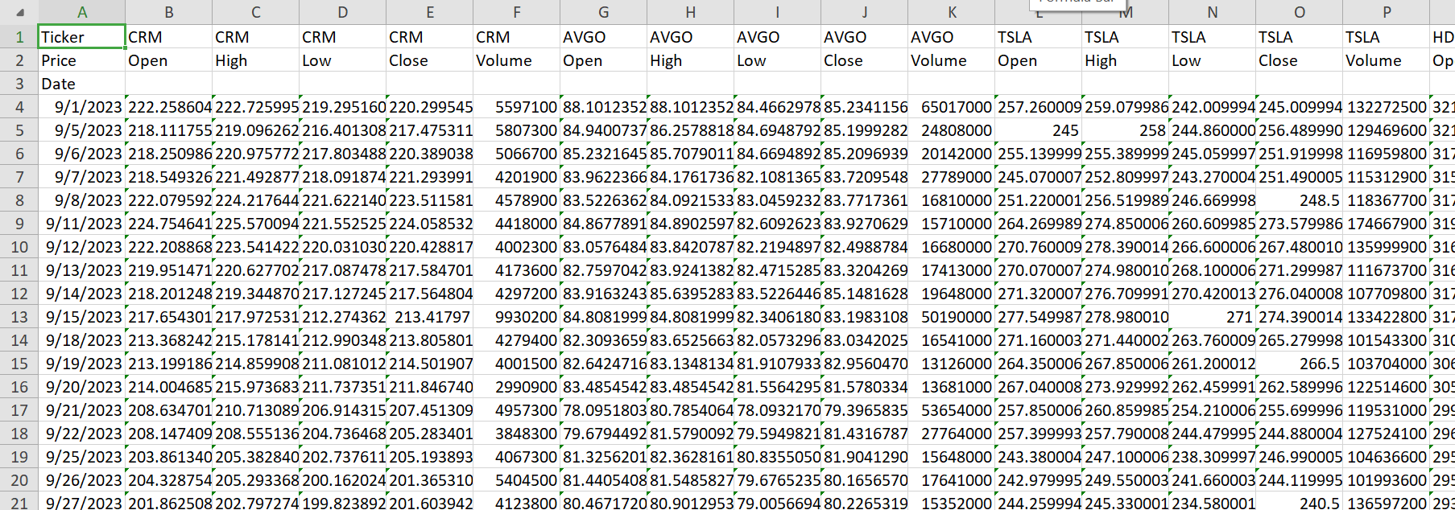
Sample Dataset:

Slide 5
Dataset and Preprocessing
Source: Yahoo Finance — 1.5 years of historical stock data (Original columns: Ticker, Date, Open, High, Low, Close, Volume)
Feature Engineering (Technical Indicators):
MACD (Moving Average Convergence Divergence) – detects trend shifts and momentum
RSI (Relative Strength Index) – identifies overbought/oversold signals
EMA (Exponential Moving Average) – gives more weight to recent prices
Volatility – measures price fluctuation over time
Returns – percentage change in closing price (daily)

Slide 6
Definitions
MACD (Moving Average Convergence Divergence)
The MACD is a trend-following momentum indicator that shows the relationship between two moving averages of a stock’s price — typically the 12-day and 26-day exponential moving averages (EMA). It helps identify potential buy/sell signals based on crossovers and divergence patterns.
RSI (Relative Strength Index)
RSI is a momentum oscillator that measures the speed and magnitude of recent price changes to evaluate overbought or oversold conditions in the market. It ranges from 0 to 100, where values above 70 suggest overbought, and below 30 suggest oversold conditions.
EMA (Exponential Moving Average)
EMA is a type of moving average that assigns greater weight to more recent prices, making it more responsive to new information compared to a simple moving average (SMA). It is commonly used to smooth out price data and identify trends more quickly.

Slide 7

Definitions
Volatility
Volatility refers to the degree of variation in a stock’s price over time, typically measured using standard deviation or the range of returns. It represents market uncertainty and risk, with higher volatility indicating more rapid and unpredictable price movements.
Returns
Returns represent the percentage change in the closing price of a stock from one day to the next. It is calculated as:
Returns are essential in performance evaluation and risk assessment.

Slide 8
Dataset and Preprocessing
Processing Steps:
Data normalized to bring features to the same scale
Reshaped into sequences for time-series modeling
Extra features were engineered to capture trends and patterns

Slide 9
Exploratory Data Analysis (EDA)
The EDA phase uncovers patterns, trends, and hidden insights before modeling begins.
Key Analyses Performed:
Volatility Assessment — to understand risk levels and price fluctuations
Price Trend Analysis — to visualize long-term growth and momentum
Unusual Volume Detection — to identify sudden trading spikes or anomalies
RSI Trend Analysis — to spot overbought or oversold stocks

Slide 10
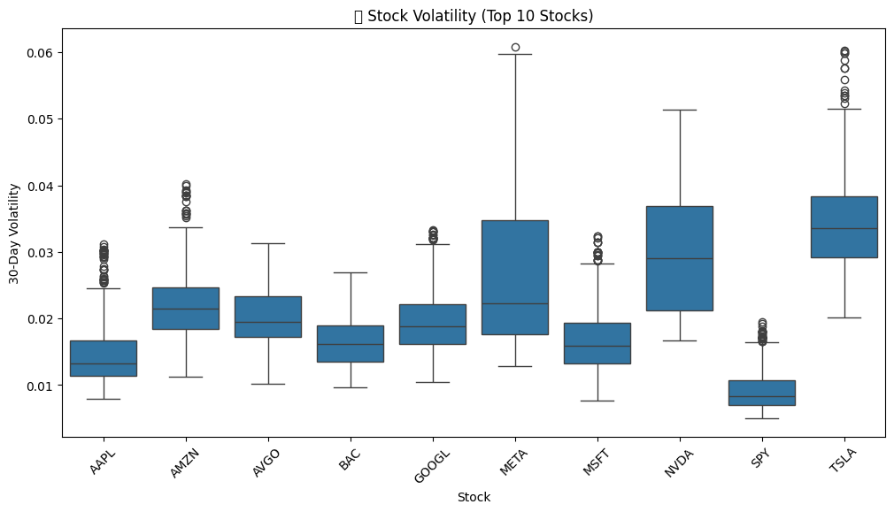
Stock Volatility Analysis

Slide 11
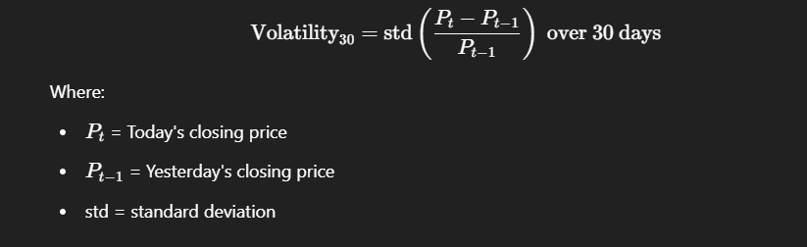
Stock Volatility Analysis
Objective
To measure and compare the 30-day price volatility of different stocks in the dataset.
Definition of Volatility
Volatility refers to the degree of variation in a stock’s price over time. It reflects the risk or uncertainty associated with price movements.
Formula Used
We computed a 30-day rolling standard deviation of daily returns:

Slide 12
Stock Volatility Analysis
Methodology
Calculated the 30-day rolling volatility for each stock
Used box plots to visualize volatility distribution and identify outliers
Key Insights
High-volatility stocks (e.g., TSLA, META) show larger price swings, indicating more risk
Low-volatility stocks (e.g., SPY, BAC) are more stable and consistent

Slide 13
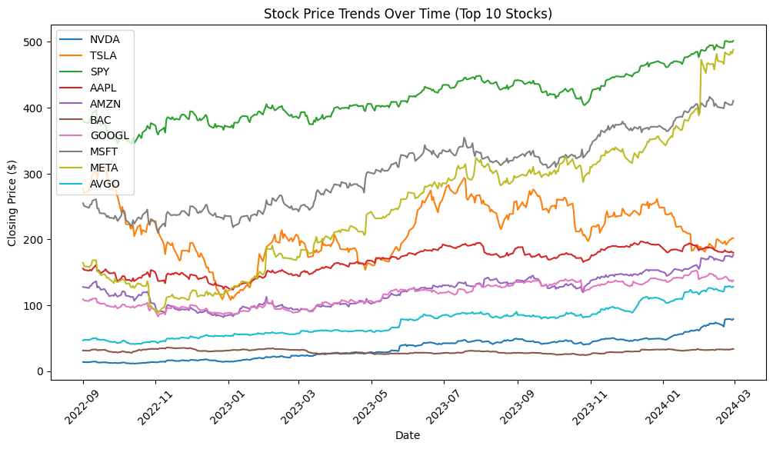
Stock Price Trends Over Time

Slide 14
Stock Price Trends Over Time
Objective
To analyze and compare the long-term price movements of the top 10 most-traded stocks.
Methodology
Collected daily closing prices over a 1.5-year period
Plotted individual stock trends on a line chart for visual comparison
Focused on identifying growth patterns and volatility behavior
Insights
Consistent uptrends observed in stable tech stocks like NVDA and MSFT
Higher volatility and swings seen in growth stocks like TSLA and META
These trends reflect investor confidence, sector momentum, and macro shifts

Slide 15
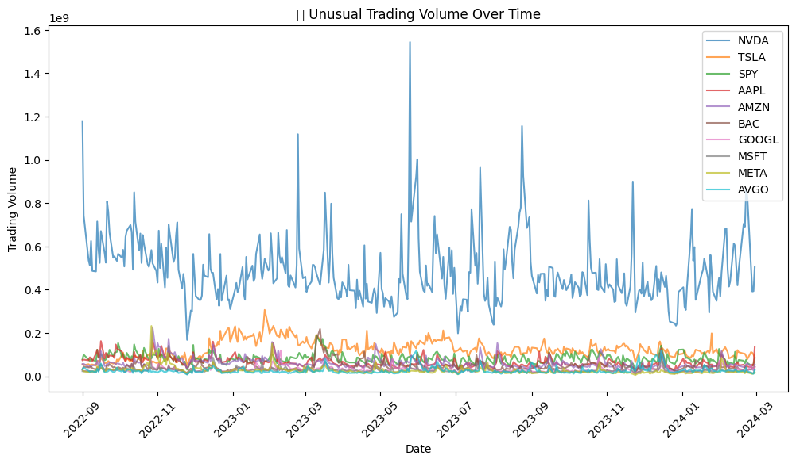
Unusual Trading Volume Detection

Slide 16
Unusual Trading Volume Detection
Objective
To identify sudden spikes in trading volume that may suggest insider trading, market manipulation, or news-driven activity.
Methodology
Analyzed daily trading volume trends across top 10 stocks
Applied a simple thresholding logic to detect outliers, where volume significantly exceeded the historical average

Slide 17
Unusual Trading Volume Detection
Why It Matters
Unusual trading volumes can:
Precede major price moves
Indicate earnings leaks, rumors, or large institutional trades
Reveal patterns not visible in price alone
Insights
Stocks like NVDA, TSLA, and AMZN exhibited frequent volume spikes
These were often aligned with earnings calls, product launches, or news cycles

Slide 18
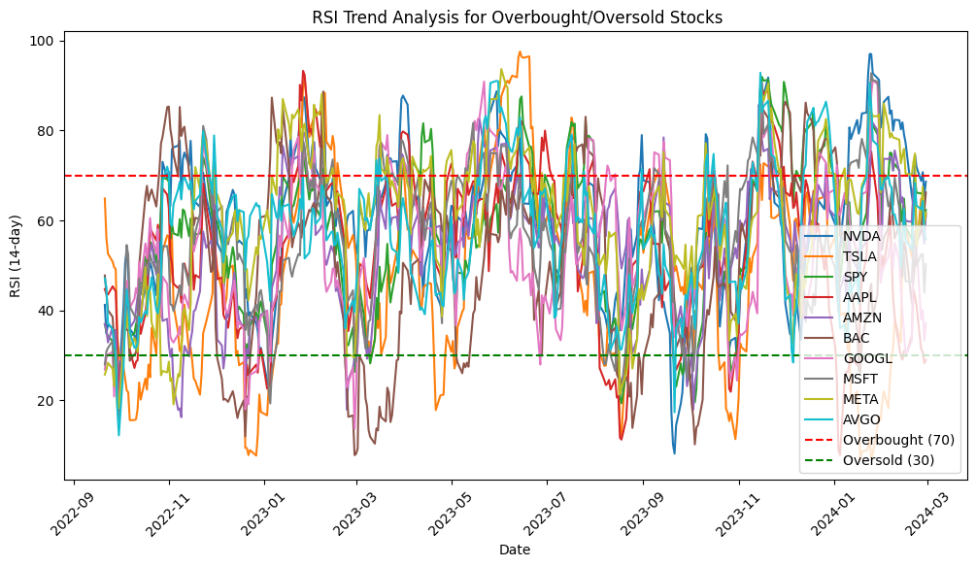
RSI Trend Analysis for Overbought/Oversold Stocks

Slide 19
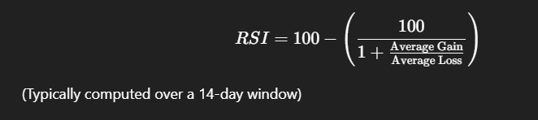
RSI Trend Analysis for Overbought/Oversold Stocks
Objective
To detect potential buy and sell signals by identifying when a stock becomes overbought (RSI > 70) or oversold (RSI < 30).
Definition: RSI (Relative Strength Index)
RSI is a momentum oscillator that measures the strength and speed of price movements over a period. It helps determine whether a stock is overvalued or undervalued.
Formula:

Slide 20
RSI Trend Analysis for Overbought/Oversold Stocks
Methodology
Calculated 14-day RSI for each stock using closing prices
Plotted RSI trends over time with reference lines at 70 and 30
Analyzed frequency and behavior around these levels
Insights
Stocks crossing above 70 may be entering overbought territory → potential sell signal
Stocks dipping below 30 may be oversold → possible buy opportunity
Some stocks (e.g., TSLA, META) fluctuate frequently, suggesting speculative activity

Slide 21
Smart Portfolio Optimization (Model 1)
Reads your uploaded CSV
Calculates historical return, volatility, and covariance
Simulates 10,000 portfolios
Finds the one with highest Sharpe Ratio
Prints summary
Recommends top 5 tickers based on allocation
Shows the Efficient Frontier chart

Slide 22
Smart Portfolio Optimization (Model 1)
Objective:
To recommend the best mix of stocks that maximizes return while minimizing risk, using Modern Portfolio Theory (MPT).
How It Works:
Analyzes historical returns, volatility, and correlation among stocks.
Simulates 10,000 portfolios to compute the Sharpe Ratio (return-to-risk).
Recommends the optimal allocation based on the highest Sharpe Ratio.
Key Concepts:
Expected Return (%): Projected annual profit based on past performance.
Risk (Volatility %): How much the stock's price fluctuates.
Sharpe Ratio: Return per unit of risk.

Slide 23
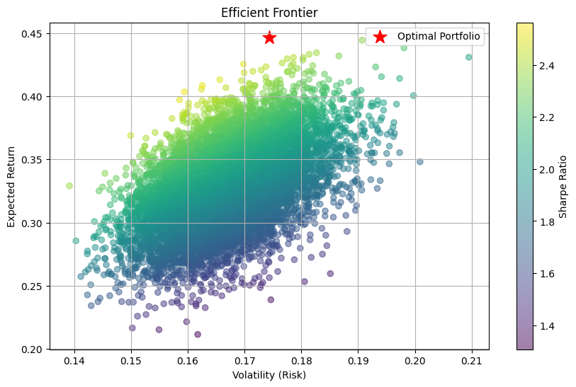
Smart Portfolio Optimization (Model 1)
Output Summary:
The selected optimized mix includes: NVDA, NVO, COST, META, SAP
This combination offers:
High expected returns
Diversified risk profile
Allocation is mathematically driven using Modern Portfolio Theory (MPT) principles.
Why It Matters:
This model eliminates guesswork. Instead of chasing the highest returns, it selects the best combination of assets to maximize return while minimizing risk the essence of intelligent investing.

Slide 24
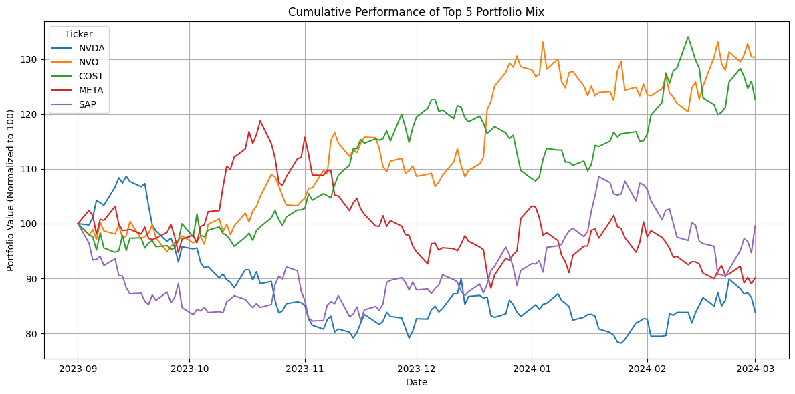
Smart Portfolio Optimization (Model 1)
This graph visualizes the performance synergy among the top 5 stocks selected by the optimization model.
While some tickers like NVDA and META exhibit periods of underperformance or higher volatility, others like NVO and COST provide steady upward trends that compensate for those dips.
The combination results in a well-balanced portfolio, where gains from strong performers help offset weaker phases — ultimately validating the risk-reducing strength of Modern Portfolio Theory (MPT).

Slide 25
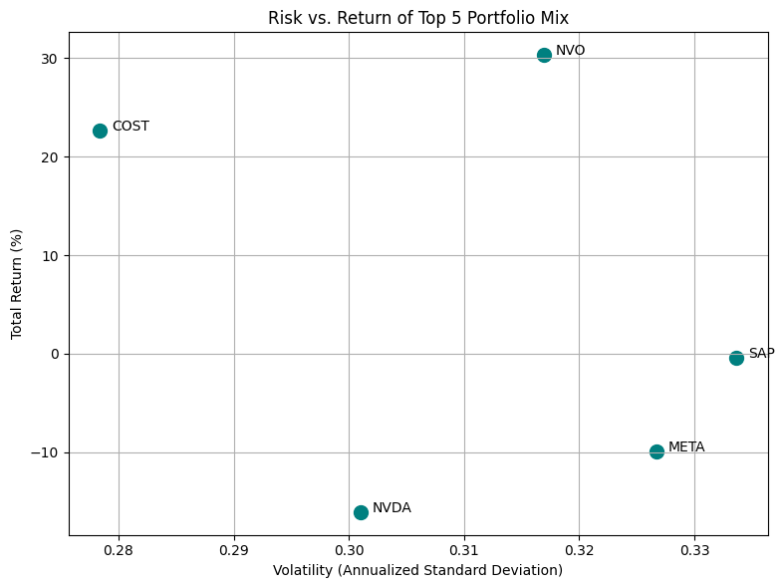
Smart Portfolio Optimization (Model 1)
Each dot represents a stock selected from the optimized portfolio.
X-axis shows risk, calculated as the annualized volatility of returns.
Y-axis shows total return over the investment period.
The goal is to find assets with high return and low volatility (top-left zone).
In this analysis:
NVO delivered the highest return (~30%) with moderate risk.
COST provided good returns (~22%) at the lowest volatility, indicating strong stability.
META and NVDA showed higher volatility but negative returns, making them less efficient in this window.

Slide 26
Anomaly Detection for Insider Trading & Market Manipulation (Model 2)
Objective: To detect sudden, abnormal price and volume movements that may signal:
Insider trading
Market manipulation (e.g., pump-and-dump schemes)
Institutional buying/selling before public disclosures
⚙️ How the Model Works: Rolling Window Method (14-Day Lookback)
The model applies a 14-day rolling window to calculate dynamic averages and standard deviations for each stock. This ensures that calculations are adaptive to recent trends, enabling the model to stay responsive to fresh data.
Example: For Jan 15, metrics are based on Jan 1–14. For Jan 16, it shifts forward to Jan 2–15.
Why It Matters: It helps detect true anomalies while avoiding overreaction to normal market movement.

Slide 27


Anomaly Detection for Insider Trading & Market Manipulation (Model 2)
Z-Score of Price
Measures how far the current price deviates from its recent average.
A Z-Score > |3| is considered statistically rare and signals strong upward/downward movement.
Volume Spike Ratio
Compares current volume to the recent average.
A ratio greater than 3 indicates abnormally high trading activity.

Slide 28
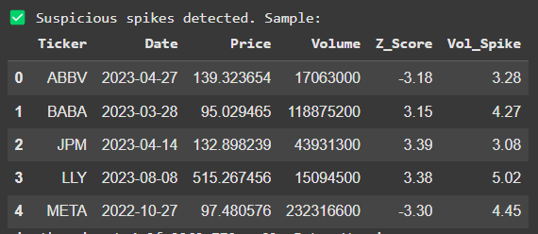
Anomaly Detection for Insider Trading & Market Manipulation (Model 2)
Interpretation
These flagged events meet both anomaly conditions:
Z-Score >|3|
Volume Spike >3
Suggests unusual, high-impact trading activity not typical of market fluctuations.
Especially concerning if no major news/public trigger is present.
Verdict
“The model effectively identifies short-term trading anomalies using rolling statistics. Its design ensures sensitivity to suspicious activity while ignoring regular market noise. It’s a valuable early detection system for regulators, analysts, and investors monitoring market integrity.”

Slide 29
Next-Day Price Prediction using LSTM (Model 3)
Objective:
To predict the next day’s closing price for 30 major stocks using LSTM-based deep learning, enabling better planning for swing traders and institutional investors.
Methodology:
Model: Stacked LSTM with Dropout regularization
Window size: 60 past days
Split: 80% training / 20% testing
Metric: RMSE (Root Mean Squared Error)
Normalization: MinMaxScaler
Epochs: 10 per ticker

Slide 30
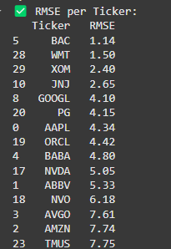
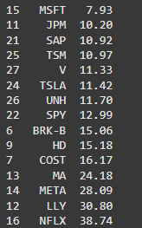
Next-Day Price Prediction using LSTM (Model 3)
Key Insights:
Best performing tickers include WMT, BAC, XOM with RMSE < 2.
Higher RMSEs (e.g., META, NFLX, LLY) likely reflect higher volatility in recent price movements.
Visual trends show predicted prices closely following actual values, especially in steady-growth stocks like BRK-B, JPM, COST.
Visual Analysis:
Faceted graph shows Predicted vs Actual Close Prices for all 30 tickers.
Some deviations appear in highly volatile tickers, but overall trends are well captured.
Most predicted curves maintain parallel alignment with true market movements, validating the model's forecasting strength.

Slide 31
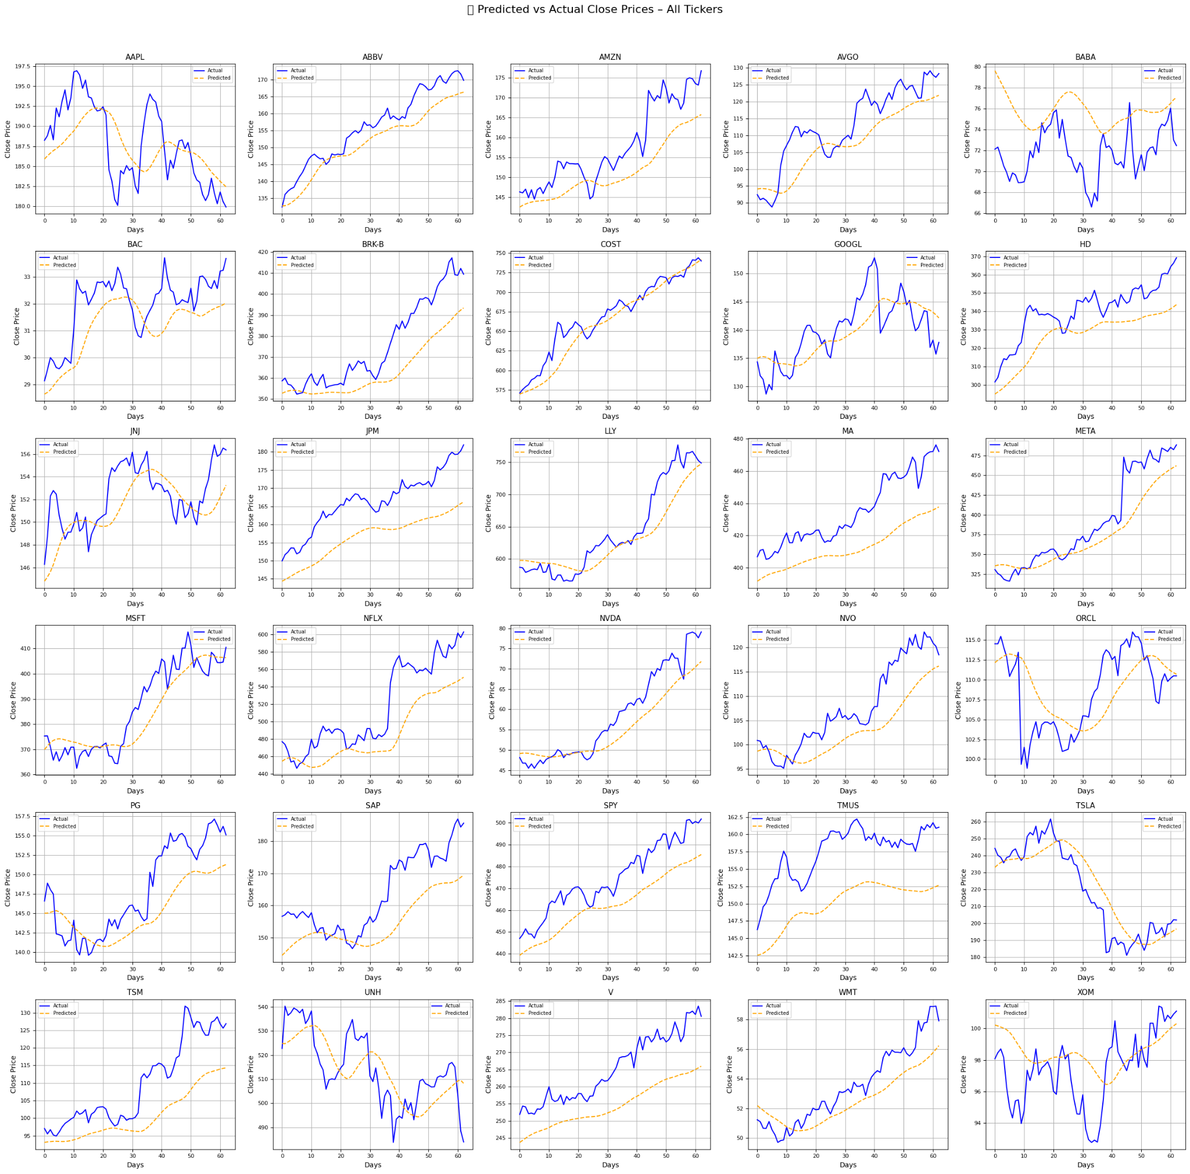
Next-Day Price Prediction using LSTM (Model 3)

Slide 32
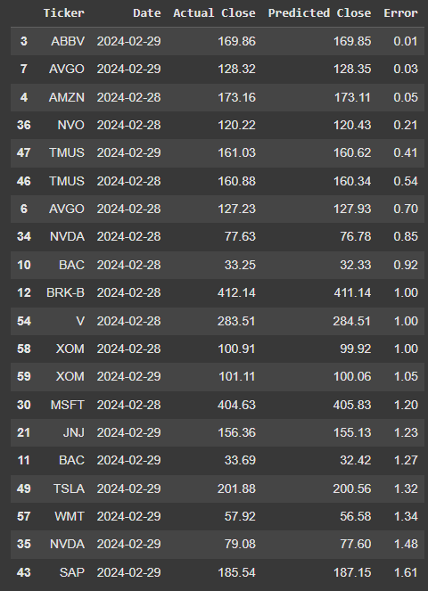
Next-Day Price Prediction using LSTM (Model 3)
Prediction Results – Key Highlights
High Accuracy: ABBV, AVGO, AMZN – errors under $0.10.
Majority Reliable: 20+ tickers with error < $1.50.
Outliers: Higher error in volatile stocks like LLY, NVDA.
Overall: LSTM shows strong short-term forecasting ability.

Slide 33
Hidden Correlation Discovery Between Stocks (Model 4)
What is it?
This model identifies hidden patterns and relationships between multiple stocks.
Helps investors group similar stocks and diversify intelligently.
Especially useful to detect sectoral or behavioral clustering.
Techniques Used
Pearson Correlation Matrix
Measures the linear relationship between pairs of stocks.
Range: -1 to 1 (1 = perfect positive, -1 = perfect negative).
Blue = weak correlation, Red = strong correlation.
Hierarchical Clustering (Dendrogram)
Groups stocks based on similarity in price movement.
Visualizes which stocks move together over time.
Useful to identify redundant holdings or diversification opportunities.

Slide 34
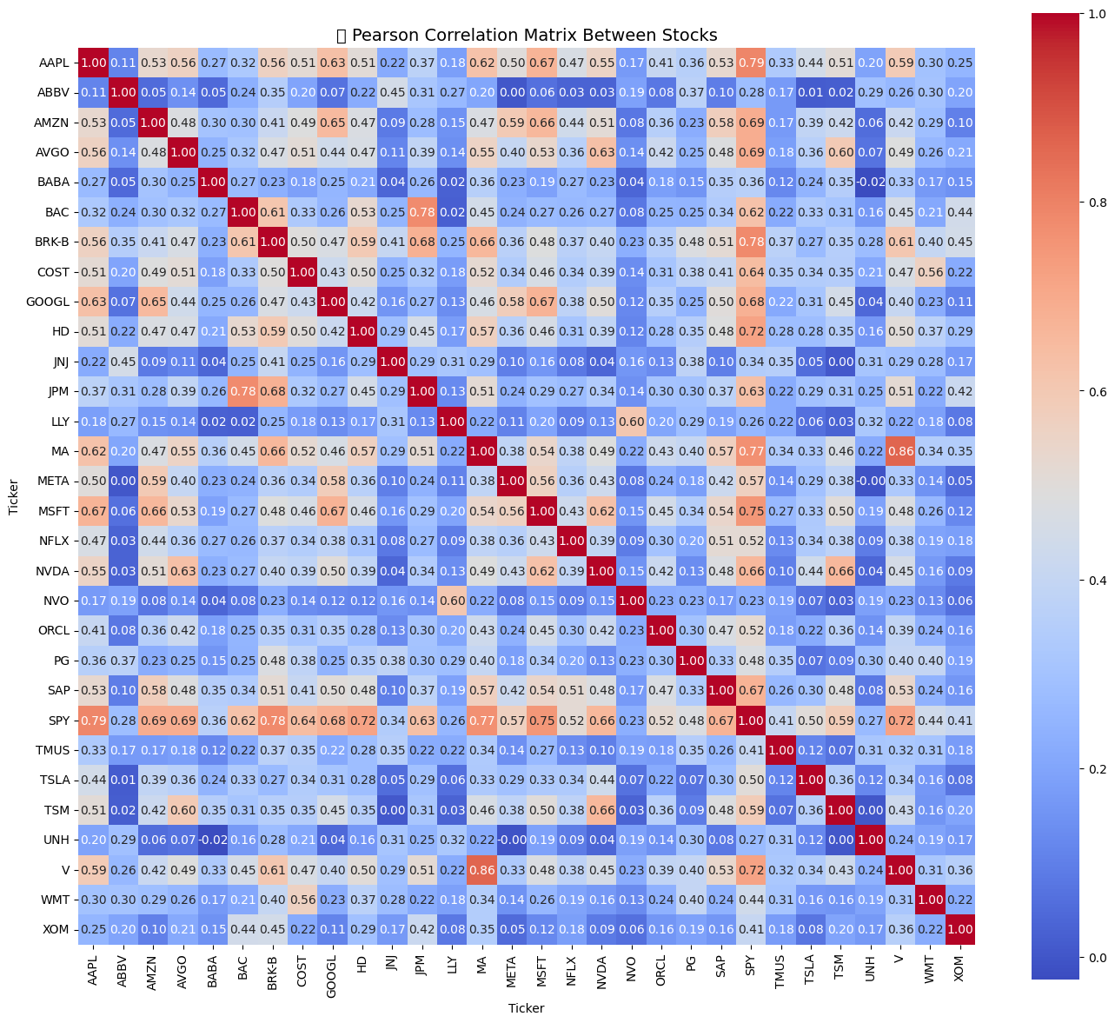
Hidden Correlation Discovery Between Stocks (Model 4)
Insights from Graphs
Correlation Matrix
Shows pairwise correlation between all 30 tickers.
AAPL & MSFT: Highly correlated → Both in tech sector.
XOM & LLY: Low correlation → Good candidates for diversification.

Slide 35
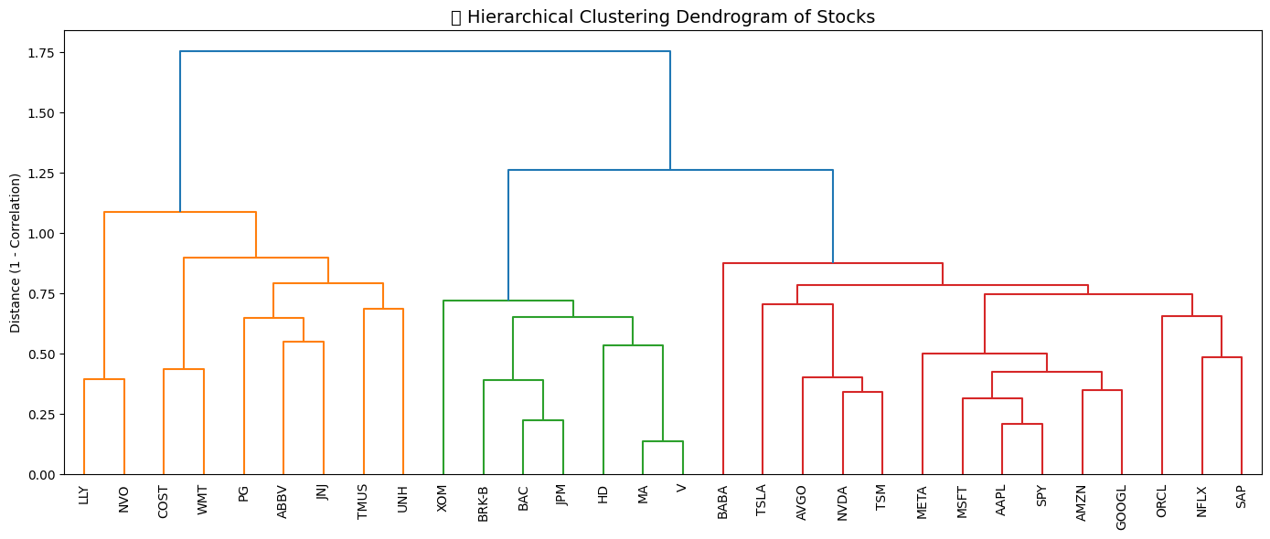
Hidden Correlation Discovery Between Stocks (Model 4)
Insights from Graphs
Dendrogram (Right)
Automatically groups stocks into clusters (like Tech, Healthcare, Energy).
Example: TSLA, NVDA, META fall into the same cluster → Trend-followers.
Diversified allocation could include one from each major branch for safety.

